Slide 1
Pointers

Slide 2
Pointers
Pointers in C language is a variable that stores/points the address of another variable.
A Pointer in C is used to allocate memory dynamically i.e. at run time.
The pointer variable might be belonging to any of the data type such as int, float, char, double, short etc.
Pointer usage reduces the access time of a variable.
The size of the pointer depends on the architecture.

Slide 3


int a;
a=10;
int *p;
p=&a;

Slide 4
Operators used with pointers
Referencing operator (&)
- used to specify address of a variable
2. de-referencing operator (*)
- used for two purposes,
a) pointer declarator
b) value at operator

Slide 5
Syntax
Declaration:
  type *ptr_variable;
  Example:
int *p;
Initialization:
int n = 10; // variable whose address need to be stored into the pointer
int* p; // declaring pointer variable
p=&n;// storing address of ‘n’ into the pointer variable ‘p’

Slide 6
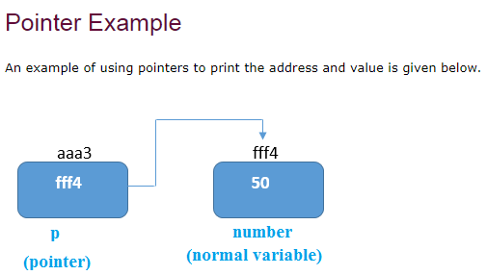
Pointer Address Format

Slide 7
Explanation
Pointer variable stores the address of number variable, i.e., fff4.
The value of number variable is 50. But the address of pointer variable p is aaa3.
By the help of * (indirection operator), we can print the value of pointer variable p.

Slide 8
Address Of (&) Operator
The address of operator '&' returns the address of a variable. But, we need to use %u or %p format specifier to display the address of a variable.
#include<stdio.h>
int main(){
int number=50;
printf("value of number is %d, number);
printf(“ address of number is %p“, &number);
return 0;
}

Slide 9
Example program
#include <stdio.h>
int main()
{
int a=10;
int *p;
p=&a;
printf("\n a: %d",a);
printf("\n &a: %u",&a);
printf("\n p: %u",p);
printf("\n p: %u",&p);
printf("\n *p: %d",*p);
}

Slide 10
Example program
#include <stdio.h>
int main()
{
int a=10;
int *p;
p=&a;
printf("\n a: %d",a);
printf("\n &a: %u",&a);
printf("\n p: %u",p);
printf("\n p: %u",&p);
printf("\n *p: %d",*p);
}
Output:
a: 10
&a: 1386055356
p: 1386055356
p: 1386055344
*p: 10

Slide 11
Size of pointer
On 64-bit machines, pointers take up 8 bytes of memory
on 32-bit machines, they take up 4 bytes.

Slide 12
int main()
{
int *p1;
float *p2;
char *p3;
printf("%d %d %d", sizeof(p1), sizeof(p2), sizeof(p3));
return 0;
}
Answer : 8 8 8
Irrespective of type, since pointers stores only address.

Slide 13
Advantages of Pointers
Pointer reduces the code and improves the performance, it is used to retrieve strings, trees, etc. and used with arrays, structures, and functions.
We can return multiple values from a function using the pointer.
It makes you able to access any memory location in the computer's memory.
Pointers in c language are widely used in arrays, functions, and structures. It reduces the code and improves the performance
Dynamic memory allocation: In c language, we can dynamically allocate memory using malloc() and calloc() functions where the pointer is used.

Slide 14
Add two numbers using Pointers
#include <stdio.h>
int main()
{
int first, second, *p, *q, sum;
printf("Enter two integers to add\n");
scanf("%d%d", &first, &second);
p = &first;
q = &second;
sum = *p + *q;
printf("Sum of the numbers = %d\n", sum);
return 0;
}

Slide 15
Swapping two numbers using pointers
#include <stdio.h>
int main()
{
int x, y, *a, *b, temp;
printf("Enter the value of x and y\n");
scanf("%d%d", &x, &y);
a = &x;
b = &y;
temp = *a;
*a = *b;
*b = temp;
printf("After Swapping\nx = %d\ny = %d\n", x, y);
return 0;
}

Slide 16
NULL Pointer
A pointer that is not assigned any value but NULL is known as the NULL pointer.
If you don't have any address to be specified in the pointer at the time of declaration, you can assign NULL value.
Syntax:
int *p=NULL;

Slide 17
#include <stdio.h>
int main () {
int *ptr = NULL;
printf("The value of ptr is : %u\n", ptr );
return 0;
}
Output: The value of ptr is : 0

Slide 18
void pointer
A void pointer is a pointer that has no associated data type with it. A void pointer can hold address of any type and can be typcasted to any type.
int a = 10;
char b = 'x';
void*p;
p = &a; // void pointer holds address of int 'a'
p = &b; // void pointer holds address of char 'b'

Slide 19
When void pointer stores all the types of variable’s address, while printing value through pointers it has to be converted to corresponding type before it prints.
int a=10;
void *p;
p=&a;
printf("%d", *p); //statement will not work.
printf("%d", *(int *)p); // is correct statement.

Slide 20
C Double Pointer (Pointer to Pointer)
pointer to store the address of another pointer.
A pointer to a pointer is a form of multiple indirection, or a chain of pointers.
Normally, a pointer contains the address of a variable.
When we define a pointer to a pointer, the first pointer contains the address of the second pointer, which points to the location that contains the actual value
Syntax:
int **p;

Slide 21
Double Pointer
int main () {
int num;
int *ptr1;
int **ptr2;
num = 10;
ptr1 = &num;
ptr2 = &ptr1;
printf("Value of num = %d\n", num );
printf("Value available at *ptr1 = %d\n", *ptr 1);
printf("Value available at **ptr2 = %d\n", **ptr2);
return 0;
}

Slide 22
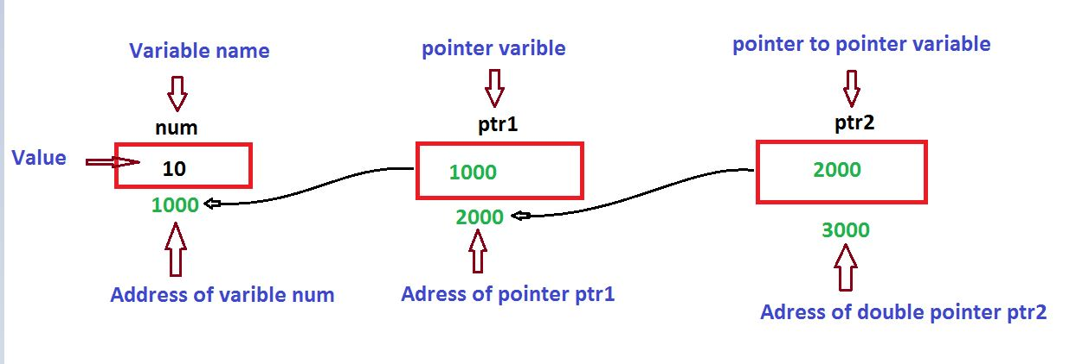
Double Pointer

Slide 23
Pointer and Arrays
Pointer to One dimensional arrays
Use a pointer to an array, and then use that pointer to access the array elements.
a[i] can be represented as *(a+i)

Slide 24
Example to access one dimensional array using pointers.
#include<stdio.h>
int main()
{
int a[3] = {1, 2, 3};
int *p = a;
for (int i = 0; i < 3; i++)
{
printf("%d ", *p);
p++;
}
return 0;
}
Output :
1 2 3

Slide 25
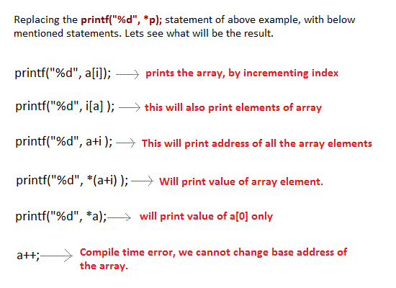


Slide 26
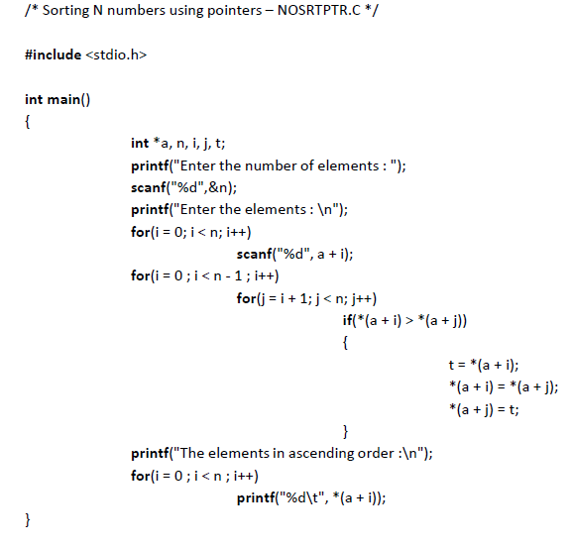

Slide 27
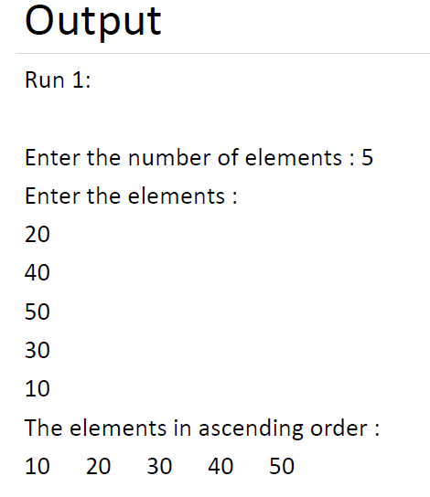

Slide 28
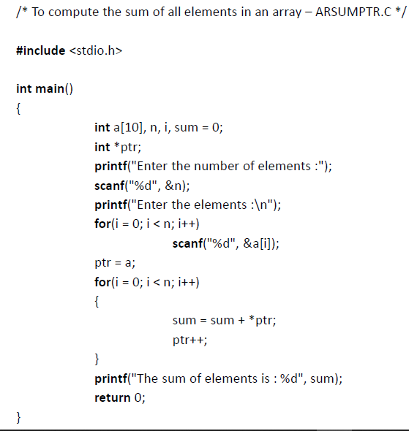

Slide 29
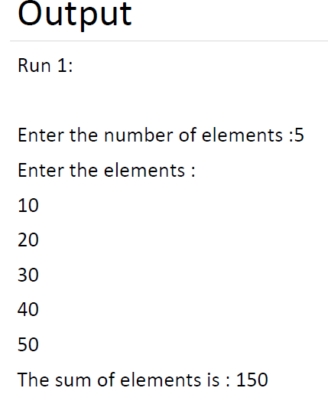

Slide 30
Pointer to multi dimensional arrays
arr[i][j] can be represented as *(*(arr+ i) + j)

Slide 31
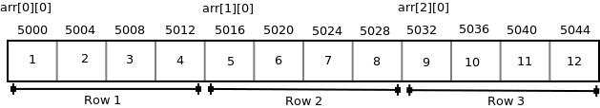
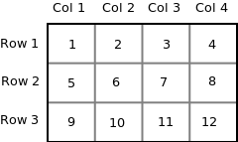
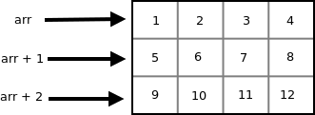

int arr[3][4] = { {1, 2, 3, 4}, {5, 6, 7, 8}, {9, 10, 11, 12} };

Slide 32
// C program to print the values of a 2-D array
#include<stdio.h>
int main()
{
int arr[3][4] = {{ 10, 11, 12, 13 },
{ 20, 21, 22, 23 },
{ 30, 31, 32, 33 }
};
int i, j;
for (i = 0; i < 3; i++)
{
for (j = 0; j < 4; j++)
{
printf("%d “, *(*(arr + i) + j));
}
printf("\n");
}
return 0;
}
Output:
10 11 12 13
20 21 22 23
30 31 32 33

Slide 33
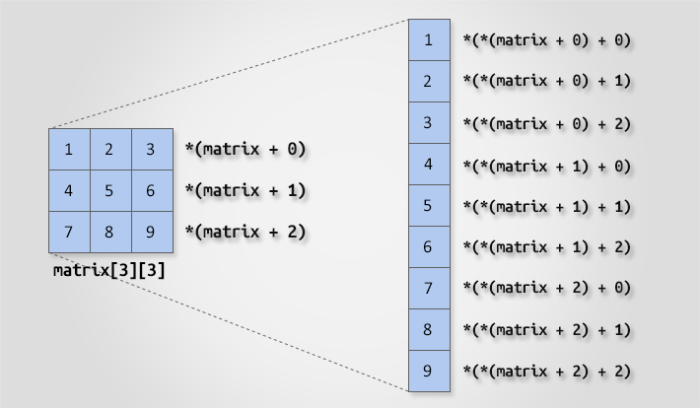
Example : int matrix[3][3];

Slide 34
MCQS

Slide 35
1. A pointer is
A. A keyword used to create variables
B. A variable that stores address of an instruction
C. A variable that stores address of a programmable entity
D. All of the above

Slide 36
1. A pointer is
A. A keyword used to create variables
B. A variable that stores address of an instruction
C. A variable that stores address of a programmable entity
D. All of the above
Answer : C

Slide 37
2. Choose the best one prior to using a pointer variable
A. It should be declared.
B. It should be initialized.
C. It should be both declared and initialized.
D. None of the above.

Slide 38
2. Choose the best one prior to using a pointer variable
A. It should be declared.
B. It should be initialized.
C. It should be both declared and initialized.
D. None of the above.
Answer : C

Slide 39
3. What is the output of this C code?
int main()
{
int *ptr, a = 10;
ptr = &a;
*ptr += 1;
printf("%d,%d/n", *ptr, a);
}
A. 10,10 B. 10,11 C. 11,10 D. 11,11

Slide 40
3. What is the output of this C code?
int main()
{
int *ptr, a = 10;
ptr = &a;
*ptr += 1;
printf("%d,%d/n", *ptr, a);
}
A. 10,10 B. 10,11 C. 11,10 D. 11,11
Answer: Option D

Slide 41
4. Find the output.
main()
{
char *p;
p="hello";
printf("%c",*&*p);
}
Hello B. h C. Some address will be printed. D.None of these

Slide 42
4. Find the output.
main()
{
char *p;
p="hello";
printf("%c",*&*p);
}
A. Hello B. h C. Some address will be printed. D.None of these
Answer : B

Slide 43
5. Comment on the following?
const int *ptr;
A. You cannot change the value pointed by ptr
B. You cannot change the pointer ptr itself
C. Both (a) and (b)
D. You can change the pointer as well as the value pointed by it

Slide 44
5. Comment on the following?
const int *ptr;
A. You cannot change the value pointed by ptr
B. You cannot change the pointer ptr itself
C. Both (a) and (b)
D. You can change the pointer as well as the value pointed by it
Answer: Option A

